Slide 1













May 22, 2023
OBJECT ORIENTED PONG GAME
COLLEGE MANAGEMENT SYSTEM
OBJECT ORIENTED APPLICATION:
TALK BUDDY

Slide 2

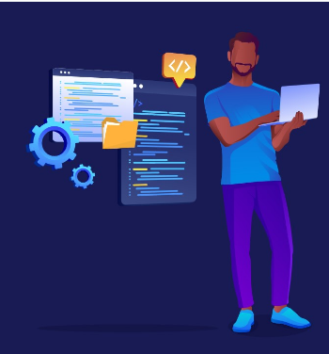



About me
Allow me to introduce myself. I am Muhammad Ahmad Sultan, a highly motivated first-year student at the Military College of Signals, currently pursuing a Bachelor's degree in Software Engineering. With unwavering determination, I am committed to achieving my goals and making significant strides in my academic journey.
Muhammad Ahmad Sultan
Developer

Slide 3






Abstract &
History
06
Scope &
Objective
08
11
Project Plan
Agenda
Functionality &
Implementation
14
OBJECT ORIENTED PONG GAME
Execution
20
OOP Concepts
27
Potential Questions
32

Slide 4



Abstract &
History
37
Scope &
Objective
39
42
Project Plan
Agenda
Functionality &
Implementation
45
Campus Management System
52
Execution
OOP Concepts
63
Potential Questions
68

Slide 5



OBJECT ORIENTED Application:
Talk Buddy
Abstract &
History
72
Scope &
Objective
74
Project Plan
77
Agenda
Functionality &
Implementation
80
Execution
84
OOP Concepts
90
94
Potential Questions

Slide 6

Object-Oriented Pong Game
Abstract
The Object-Oriented Ping Pong Game in Java is a project aimed at developing a two-player game that simulates the classic game of ping pong. Using the Java programming language and object-oriented programming concepts, this project provides a virtual platform for players to enjoy the game from the comfort of their own homes. The game incorporates features such as a user-friendly interface, scoring system, and game-over screen to engage and entertain players. By implementing OOP concepts, the code is structured and easier to maintain. This project not only offers a fun and interactive way to play ping pong but also serves as an opportunity for developers to practice and enhance their object-oriented programming skills in Java.
6

Slide 7


Object-Oriented Pong Game
History
Pong is a classic arcade video game that was first released in 1972 and became an instant hit, paving the way for the video game industry. Pong was developed by Atari, Inc., a video game company founded by Nolan Bushnell and Ted Dabney in 1972. Ping pong is a popular game that is played by people of all ages. It is a game that requires quick reflexes and excellent hand-eye coordination.
7

Slide 8

Objective
Game Objective: The aim of the ping pong game is for players to score points by hitting the ball with their paddle and preventing the ball from hitting their side of the playing area. The player with the highest score at the end of the game wins.
Project Objective: The main objective of this project is to develop an object-oriented ping pong game in Java that implements key concepts such as encapsulation, inheritance, and polymorphism.
8

Slide 9



Scope
Designing the User-friendly Interface
Implementing Multiplayer Mode
Managing Ball Movement
Handling Paddle Movement
Documentation
Handling Game Over
Creating a Scoring System
Refactoring & Optimization
9

Slide 10


Not in Scope
Tournament Mode
Online Multiplayer
AI Opponent
Networking and Database Integration
Power-ups and Special Effects
10

Slide 11

Project Plan
01
02
03
Design Phase
Implementation
Phase
Testing
Phase
Identify game features and requirements, plan game design with OOP concepts, create UI wireframes.
Develop game UI, implement game logic and rules, integrate sound effects, implement game settings, create game-over screen.
Conduct thorough testing, test on different systems, ensure requirements are met, optimize performance
11

Slide 12







Project Timeline
Four Weeks
1
2
3
4
5
Brainstorming and Idea Generation
Idea Selection
Design Phase
(1 Week)
Implementation
Phase
(2 weeks)
Testing Phase
(1 week)
12

Slide 13



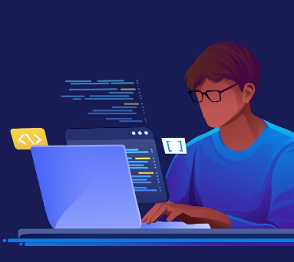
Project Budget & Team
This project will be developed using open-source tools and software, therefore there will be no cost involved.
The project will be developed by a team of one developer only.
13

Slide 14

Project Functionality & Implementation
14

Slide 15
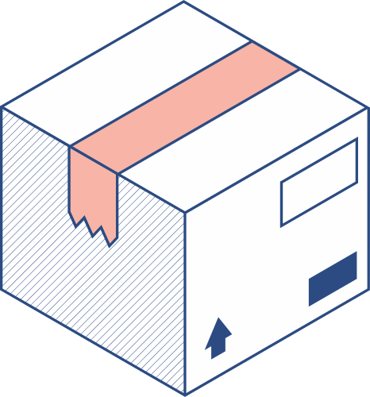


Input Specifications | Output Specifications
User Input
Keyboard inputs for player movement (up and down)
Mouse inputs for menu selection
Game Input
Ball speed and trajectory
Paddle speed and position
Score tracking
Network Input (optional)
Data transmission between networked players
Chat messages between players
User Interface
Start Menu
Game Screen
Game-Over Screen
Game Logic
Paddle Movement
Ball Movement
Collision Detection
Score Keeping
Network (optional)
15

Slide 16
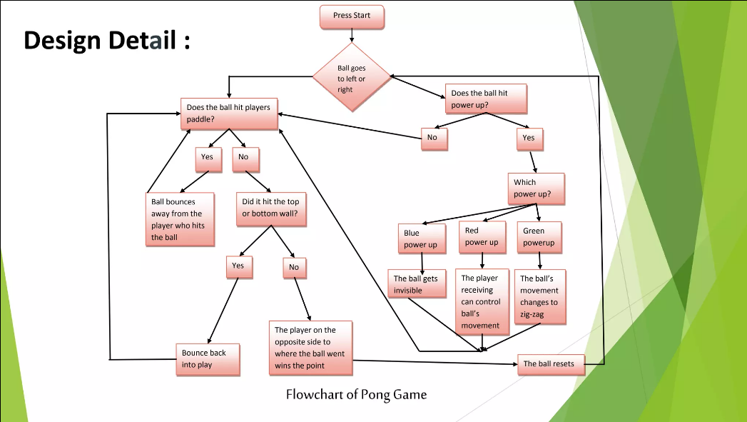

16

Slide 17


Module-Specific Requirements
User Interface Module:
Design a user-friendly interface for the game.
Provide clear instructions on how to play the game.
Allow players to start a new game and exit the game.
Game Logic Module:
Create a paddle that can be moved up and down by the players.
Implement a ball that bounces off the walls and paddles.
Create a scoring system that keeps track of the score for each player. Design a game-over screen that displays the winner.
Network Module (optional):
Allow players to play against each other over a network.
Add feature for communication between players.
17

Slide 18

Hardware Requirements | Software Requirements
Processor: Intel Core i3 or higher
RAM: 4 GB or more
Storage: 500 MB or more
Graphics card: Any modern graphics card that supports OpenGL 2.0 or higher
Monitor: 1280x800 or higher resolution display
Input devices: Keyboard and mouse or game controller
Operating System: Windows 10 or any Linux distribution that supports Java
Java Development Kit (JDK) version 11 or higher
Integrated Development Environment (IDE): Eclipse, NetBeans, or IntelliJ IDEA
OpenGL 2.0 or higher graphics library
Game Libraries
JBox2D: a 2D physics engine for games in Java
LWJGL: Lightweight Java Game Library for OpenGL
18

Slide 19

Algorithm Details
Game Loop Algorithm: Continuous running of the game by updating game state and rendering the screen.
Collision Detection Algorithm: Detect collisions between ball, paddles, and window edges.
Movement Algorithm: Update positions of paddles and ball.
Draw Algorithm: Render game screen by drawing paddles, ball, and score.
Keyboard Input Algorithm: Detect player input for paddle movement.
Randomization Algorithm: Generate random starting position and velocity for the ball.
Score Keeping Algorithm: Track and display player scores.
19

Slide 20

Execution
20

Slide 21
21

Slide 22

MainWindow.java
PongGame.java
Classes
Paddle.java
GamePanel.java
GameFrame.java
Ball.java
22
Score.java

Slide 23


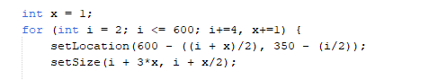
MainWindow.java
This class extends JFrame and implements the Runnable interface. It represents the main window of the game. It creates a window with an image, starts a new thread, and handles the animation for the initial appearance of the window. After a certain time, it makes the window invisible and opens a new GameFrame window.
23

Slide 24
PongGame.java | Paddle.java
The PongGame class is the entry point of the pong game. It creates an instance of the GameFrame class, which represents the game window and handles the game's logic. The program execution continues within the GameFrame class until the game is closed or completed.
The Paddle class represents the paddle in the game. It extends the Rectangle class and contains properties and methods related to the paddle's movement, such as handling key events for moving the paddle up and down. The Paddle class is used to create and control the paddles in the game.
24

Slide 25
Ball.java
GamePanel.java
The Ball class represents a ball object in a ping pong game. It extends the Rectangle class and has properties for the ball's velocities and random generator. It provides methods for setting directions, moving the ball, and drawing it on a Graphics object. The class encapsulates the behavior and attributes of a ball in the game.
This class extends JPanel and implements the Runnable interface. It represents the game panel where the game objects are drawn and animated. It contains methods for creating and moving the ball, creating and controlling the paddles, handling collision detection, and drawing the game objects. The GamePanel class is the core component responsible for the game's logic and rendering.
25

Slide 26
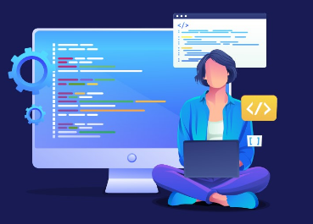
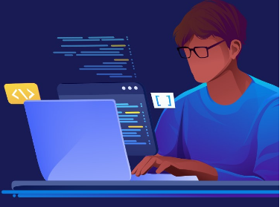
GameFrame.java
This class extends JFrame, a class in the Swing library, and is responsible for creating the main window of the game. It creates a GamePanel object and adds it to the JFrame. It sets some of the JFrame's attributes, such as its size, background color, and title, and makes it visible.
Score.java
The Score class represents the score display in the Pong game. It extends the Rectangle class and has properties for player scores.
The draw method is responsible for drawing the scores on the screen using the Graphics object.
The scores are displayed in red color with a specific font and positioned in the middle of the game window.
Getter and setter methods are provided to access and modify the player scores.
The Score class handles the visual representation and manipulation of scores in the Pong game.
26

Slide 27
Object-Oriented
Programming
Concepts
27

Slide 28

ENCAPSULATION
POLYMORPHISM
INHERITANCE
Inheritance is the process by which one class (called the subclass) acquires the properties and behavior of another class (called the superclass). This allows for the creation of hierarchical classifications of objects, where subclasses inherit the characteristics of their super classes and add additional functionality.
Encapsulation is a mechanism that binds data and code together, protecting them from external interference and misuse. It is achieved through the use of access modifiers such as public, private, and protected, which control the visibility of data and methods in a class
Polymorphism is a feature that allows objects of different classes to be treated as if they belong to a common class. This means that a single interface or method can be used to perform operations on objects of different types. This is achieved through the use of method overloading and overriding, as well as through the implementation of interfaces and abstract classes.
28

Slide 29
OOP Concept
Classes and Objects: The code defines multiple classes, such as GameFrame, Score, and Ball, which are used to create objects and encapsulate related properties and behaviors.
Inheritance: The GameFrame class extends the JFrame class, inheriting its properties and behaviors. Similarly, the Score class extends the Rectangle class, and the Ball class extends the Rectangle class as well.
Encapsulation: The classes encapsulate their properties and methods, allowing for data hiding and providing controlled access through public and private access modifiers. For example, the Score class encapsulates the player scores and provides public methods to get and set the scores.
Method Overriding: The draw method in the Score and Ball classes overrides the draw method from the Rectangle class. The overridden methods provide custom implementation to draw the score and ball on the screen.
29

Slide 30
OOP Concept
Constructor: The classes define constructors, such as the GameFrame constructor, which are used to initialize the objects when they are created. Constructors have the same name as the class and are called when an object is instantiated.
Polymorphism: Polymorphism is a fundamental concept in OOP. It allows objects of different classes to be treated as objects of a common superclass. Polymorphism enables code reusability and flexibility by allowing different objects to be used interchangeably through inheritance and method overriding.
By utilizing these OOP principles & concepts, this project will create a well-structured and maintainable codebase for the ping pong game
30

Slide 31

Future Enhancements & Works
Advanced AI Opponent
Online Multiplayer
Power-ups and Special Effects
Tournament Mode
Customization Options
31

Slide 32

Potential Questions
How could the GameFrame class be updated to support customizable game settings, such as paddle size, ball speed, or background themes, in the Pong game?
What changes would be necessary in the Score class to implement a leaderboard feature that keeps track of high scores in the Pong game?
How can the AI opponent in the Pong game be enhanced to provide different difficulty levels, allowing players to choose between easy, medium, and hard opponents?
1
2
3
32

Slide 33
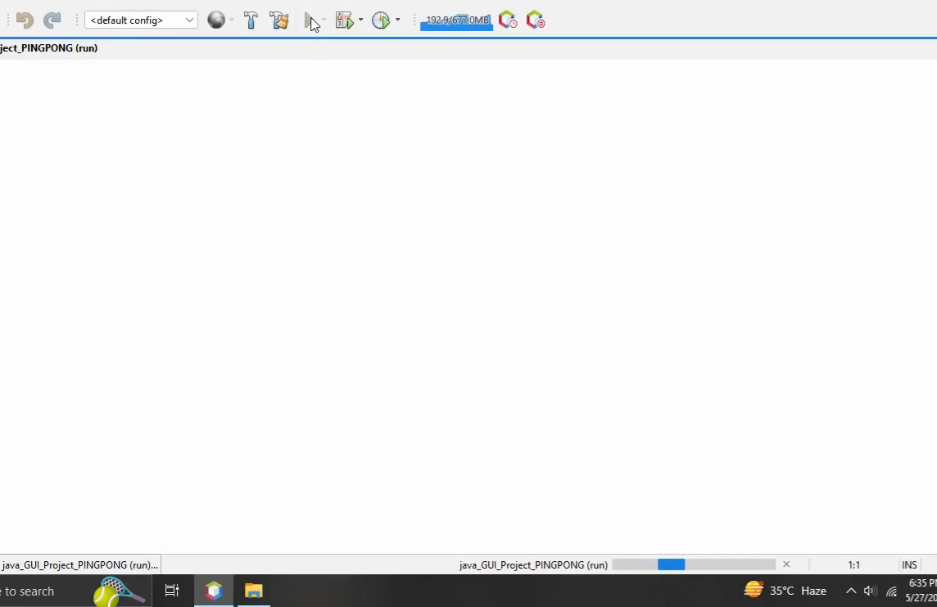

Project Demo
33

Slide 34
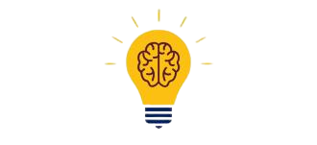
Reference Citations
https://www.w3schools.com/
https://stackify.com/java-tutorials//
https://www.codecademy.com/learn/learn-java
https://www.learnjavaonline.org/
34

Slide 35

Any Questions?
Thank you all for your attention! Before we conclude,
I would like to open the floor for questions. Please
feel free to ask anything related to the presentation
or any additional points you'd like to discuss.
35

Slide 36


THANK YOU
Sincerely for your kind attention
36

Slide 37
College Management System
Abstract
The College Management System is a comprehensive and efficient software solution designed to streamline and enhance the administrative and academic operations of a college or educational institution. Built using object-oriented programming principles in Java, this project aims to provide a user-friendly interface and automate various tasks involved in managing a college. Overall, the College Management System is a powerful tool that brings efficiency, accuracy, and transparency to the administrative and academic processes of a college. By automating routine tasks and providing reliable data management, it empowers stakeholders to focus on delivering high-quality education and fostering a conducive learning environment.
37

Slide 38

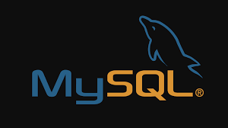
College Management System
Introduction
The College Management System has been developed using Java as the core programming language, leveraging the power of Java Swing and AWT toolkits for creating a user-friendly graphical interface. The MySQL database serves as the robust data management system, seamlessly integrated with the project using JDBC for efficient data handling. Following the principles of object-oriented programming, the project's code is structured for modularity and reusability. An IDE like Eclipse, IntelliJ IDEA, or NetBeans has been utilized for coding, debugging, and project management, while version control, such as Git, ensures effective collaboration and source code management.
38

Slide 39
Objective
Automation of Administrative Tasks
Streamlined Data Management
Enhanced Communication and Collaboration
Improved Decision-Making
Accuracy and Data Integrity
User-Friendly Interface
Scalability and Future Growth
Integration Possibilities
Security and Privacy
Cost and Time Efficiency
39

Slide 40
Scope
Designing the User-friendly Interface
Student Management
User Roles and Authentication
Faculty Management
Fee Management
Leave Management
Result Management
Examination Management
40

Slide 41
Not in Scope
Library Management
Alumni Management
Hostel Management
Online Learning and Course Management
Financial Management
41

Slide 42
Project Plan
01
02
03
Design Phase
Implementation
Phase
Testing
Phase
Identify college management features and requirements, plan college management system design with OOP concepts, create UI wireframes.
Develop college management system UI, implement college management system logic and rules, implement college management system settings.
Conduct thorough testing, test on different systems, ensure requirements are met, optimize performance
42

Slide 43
Project Timeline
Seven Weeks
1
2
3
4
5
Brainstorming and Idea Generation
Idea Selection
Design Phase
(3 Week)
Implementation
Phase
(3 weeks)
Testing Phase
(1 week)
43

Slide 44
Project Budget & Team
This project will be developed using open-source tools and software, therefore there will be no cost involved.
The project will be developed by a team of one developer only.
44

Slide 45
Project Functionality & Implementation
45

Slide 46
Input Specifications
Student Details:
Input student information such as name, address, contact details, date of birth, and enrollment number.
Faculty Details:
Input faculty member information, including name, contact details, designation, and employee ID.
Leave Application:
Accept leave requests from students and faculty members, requiring inputs such as leave type, start date, end date, and reason.
Examination Marks:
Input examination marks for students, including subject-wise scores and overall grades.
Fee Details:
Input fee-related information, including tuition fees, additional charges, discounts, and payment deadlines.
Course Registration:
Accept student course preferences for each semester, including course codes, timings, and faculty assignments.
46

Slide 47
Output Specifications
Student and Faculty Details:
Display the stored information for students and faculty members, including personal details, contact information, and academic records.
Leave Status:
Provide the status of leave requests, indicating whether they have been approved or rejected.
Result Card:
Generate and print result cards for students, displaying subject-wise marks, grades, and overall performance.
Fee Form:
Generate and print fee forms for students, presenting the amount due, payment deadlines, and payment methods.
Reports and Analytics:
Generate reports and analytics based on various parameters such as student performance, attendance, fee payment status, and other relevant metrics.
Fee Structure:
Display the fee structure, including tuition fees, additional charges, and any applicable discounts.
47

Slide 48
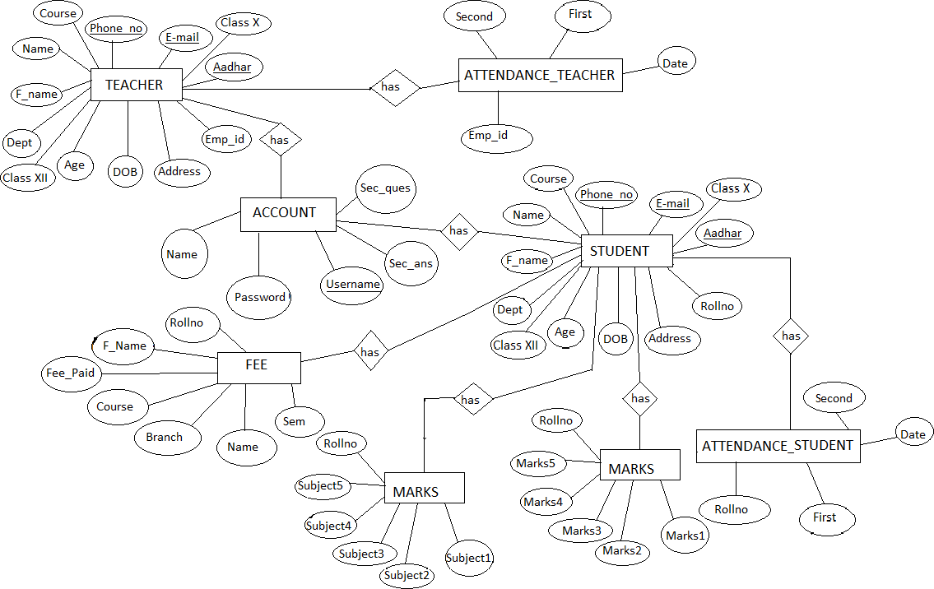
48

Slide 49
Hardware Requirements | Software Requirements
Processor Brand : Intel
Processor Type : Core i3
Processor Speed : 2 GHz
Processor Count : 1
RAM Size : 2 GB
Memory Technology : DDR3
Computer Memory Type : DDR3 SDRAM
Hard Drive Size : 160 GB
Operating system : Windows 10
Application server : JAVA (NetBeans)
Front end : JAVA
Connectivity: JDBC Driver
Database connectivity : WAMP (MYSQL Console)
49

Slide 50
Overview of Front-End
By selecting Java as the front-end technology, you can leverage its features such as platform independence, scalability, flexibility, and event-driven programming. Java Swing and AWT toolkits can be utilized for creating the graphical user interface (GUI) components, allowing for the development of user-friendly interfaces that meet the needs of employees from non-IT backgrounds. The Java language's rich ecosystem and libraries provide excellent support for reporting features and printing capabilities. Furthermore, Java's popularity and widespread adoption make it a suitable choice for long-term development and maintenance. It offers strong debugging and testing tools, facilitating the identification and resolution of issues during the development process.
50

Slide 51

Overview of Back-End
After careful consideration of various factors, we chose MySQL as the back-end technology for our project. MySQL is a popular and efficient relational database management system (RDBMS) that offers scalability, security features, and robust data handling capabilities. It provides inherent support for multiple users, efficient data retrieval, and maintenance, and compatibility with different operating systems. With its widespread popularity, strong community support, and availability of drivers, MySQL seamlessly integrates with the chosen front-end technology. Its open-source nature and compatibility with
various programming languages make it a reliable choice for our
project's back-end needs, ensuring smooth data management
and optimal performance.
51

Slide 52
Execution
52

Slide 53
53

Slide 54
MainWindow.java
Login.java
Classes
Project.java
AddStudent.java
AddTeacher.java
dbConnectivity.java
feeStructure.java
54

Slide 55
UpdateStudent.java
UpdateTeacher.java
Classes
Leave.java
EnterMarks.java
LeaveDetails.java
ExaminationDetails.java
About.java
55

Slide 56
Database Queries
Create database
Use database you just created
Create login table
Insert some values in the login table
Create student table
Create teacher table
Create student leave table
Create teacher leave table
Create table to store subjects
Create table to store marks
Create table for fee structure
Insert some values in the table
Create table to store student fee details
56

Slide 57
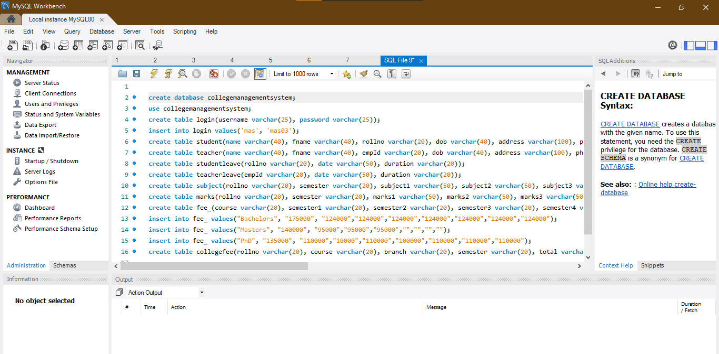
57

Slide 58
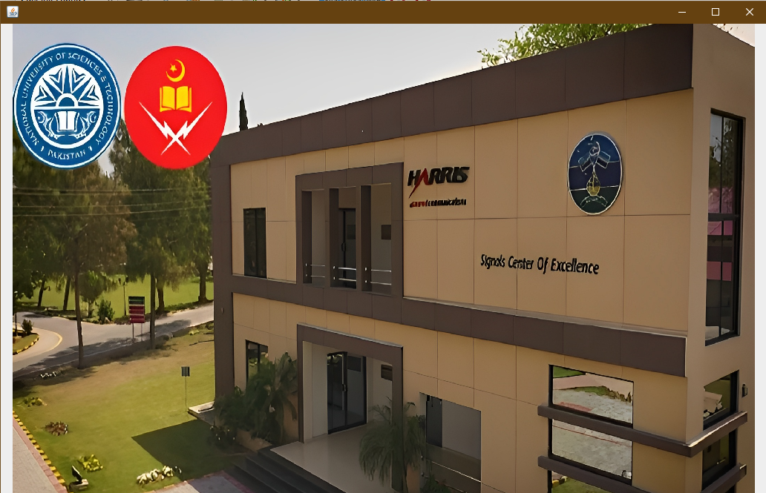
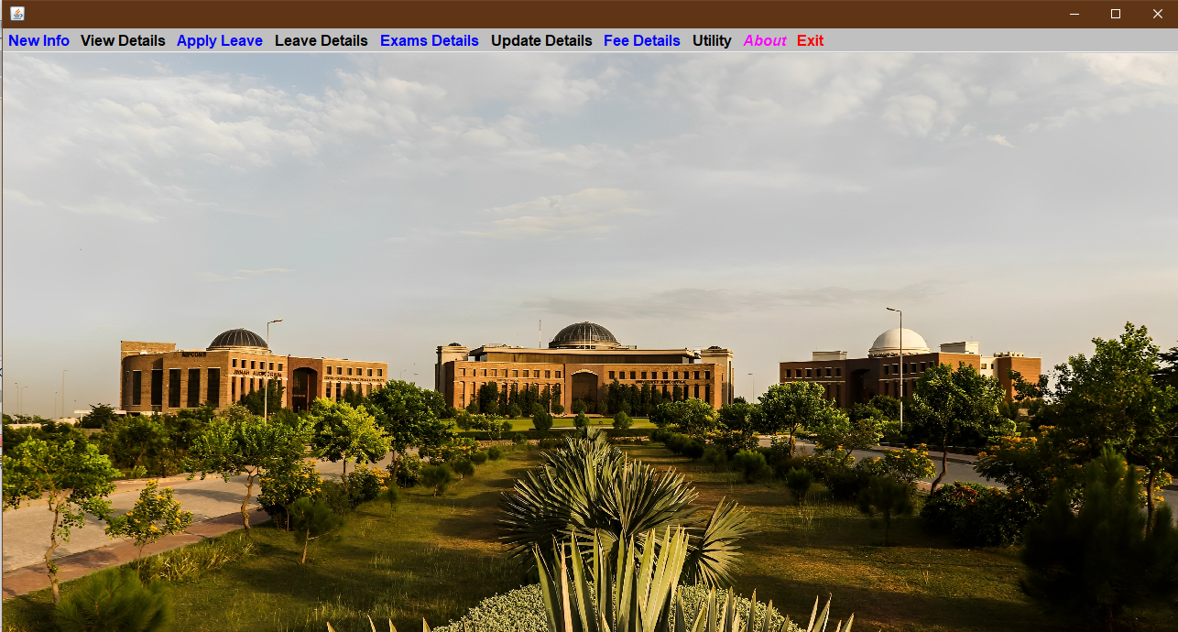
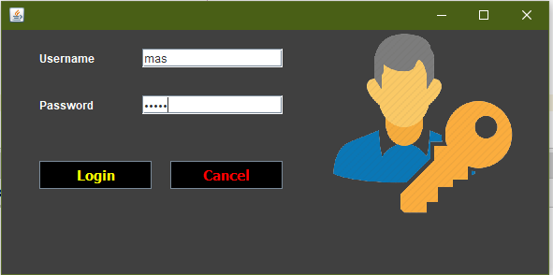
58

Slide 59
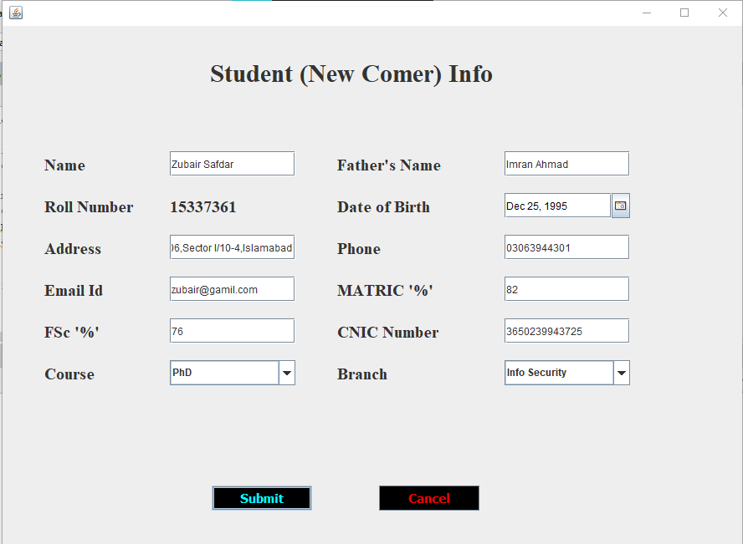
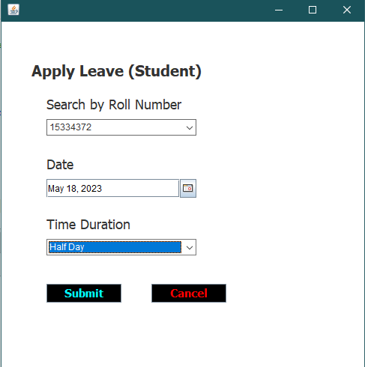
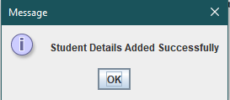
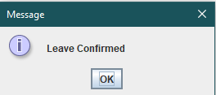
59

Slide 60
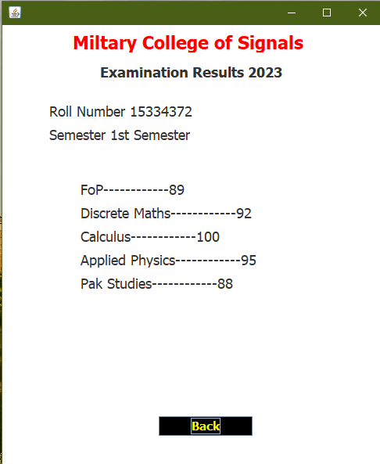
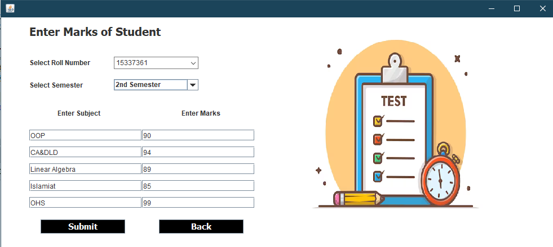
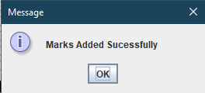
60

Slide 61
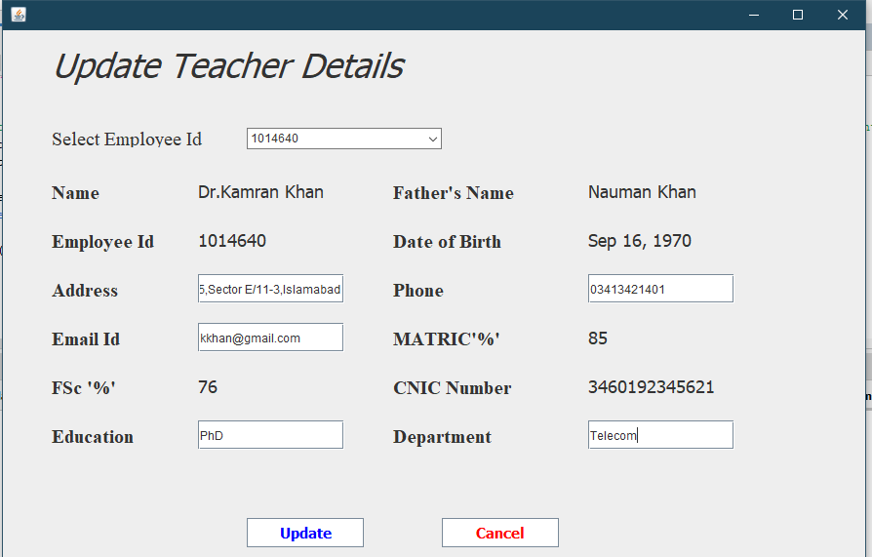
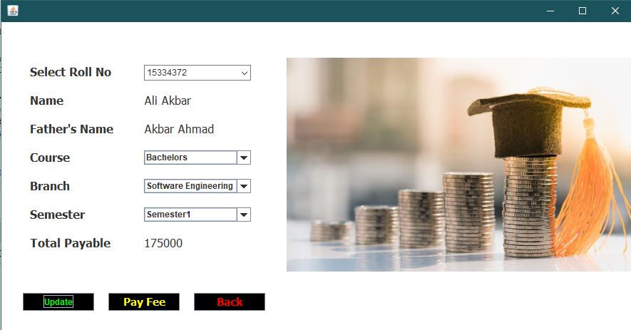
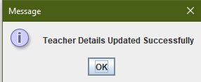
61

Slide 62
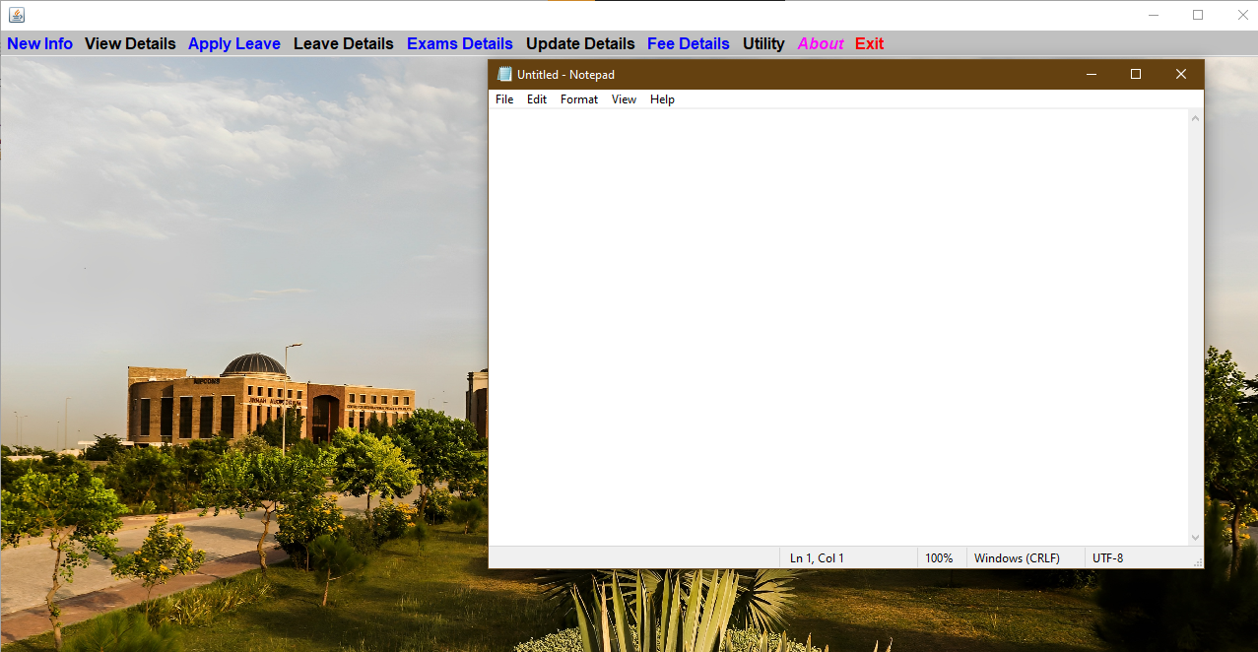
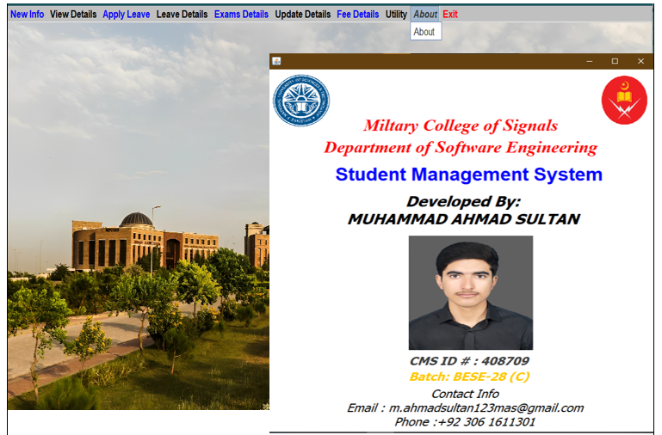
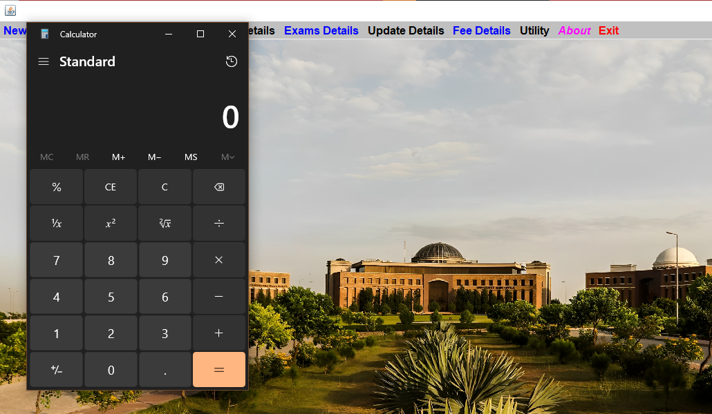
62

Slide 63
Object-Oriented
Programming
Concepts
63

Slide 64
ENCAPSULATION
POLYMORPHISM
INHERITANCE
Inheritance is the process by which one class (called the subclass) acquires the properties and behavior of another class (called the superclass). This allows for the creation of hierarchical classifications of objects, where subclasses inherit the characteristics of their super classes and add additional functionality.
Encapsulation is a mechanism that binds data and code together, protecting them from external interference and misuse. It is achieved through the use of access modifiers such as public, private, and protected, which control the visibility of data and methods in a class
Polymorphism is a feature that allows objects of different classes to be treated as if they belong to a common class. This means that a single interface or method can be used to perform operations on objects of different types. This is achieved through the use of method overloading and overriding, as well as through the implementation of interfaces and abstract classes.
64

Slide 65
OOP Concept
Classes and Objects: Different classes can be created to represent various entities in the college management system, such as Student, Faculty, Course, Department, etc. Objects of these classes can then be instantiated to represent individual students, faculty members, courses, and departments.
Inheritance: Inheritance can be used to establish relationships between classes in the college management system. For instance, a base class like Person can be created, which can be extended by subclasses like Student and Faculty to inherit common attributes and behaviors.
Encapsulation: Encapsulation can be applied to the classes in the college management system to encapsulate data and functionality. For example, the Student class can encapsulate student-specific details like name, ID, and enrolled courses, while providing methods to access and modify this information securely
65

Slide 66
OOP Concept
Method Overriding: Method overriding can be employed in the college management system when there is a need to provide custom implementations of inherited methods. For instance, the display Information() method in the Student class can override the same method in the Person class to display student-specific information.
Constructor: Constructors can be utilized in various classes of the college management system to initialize object properties when they are created. For example, a constructor in the Course class can be used to set initial values such as course code, title, and credits.
Polymorphism: Polymorphism can be utilized in the college management system to treat objects of different classes as objects of a common superclass or interface. This allows for flexibility and code reusability. For example, a method that processes students' attendance can accept both Student and Faculty objects, treating them as instances of a common Person superclass.
By utilizing these OOP principles & concepts, this project will create a well-structured and maintainable codebase for the college management system
66

Slide 67
Future Enhancements & Works
Financial Management Integration
Alumni Management
Library Management
Hostel Management
Online Learning and Course Management.
Recruitment and Placement:
Research Management
67

Slide 68
Potential Questions
How does the College Management System leverage AI algorithms or machine learning techniques to analyze student performance data and provide personalized recommendations for academic support or interventions?
How does the College Management System ensure data security and privacy for sensitive student and faculty information?
How does the College Management System facilitate effective communication and collaboration between parents/guardians and the educational institution to ensure transparent and timely updates on student progress and involvement?
1
3
2
68

Slide 69
Reference Citations
https://www.w3schools.com/
https://stackify.com/java-tutorials//
https://www.codecademy.com/learn/learn-java
https://www.learnjavaonline.org/
69

Slide 70
Any Questions?
Thank you all for your attention! Before we conclude,
I would like to open the floor for questions. Please
feel free to ask anything related to the presentation
or any additional points you'd like to discuss.
70

Slide 71
THANK YOU
Sincerely for your kind attention
71

Slide 72

Object-Oriented Application: Talk Buddy
Abstract
The Object-Oriented Application: Talk Buddy presents a simple chat application implemented using Java Swing and socket programming. The application consists of a server-side component and a client-side component that enable users to exchange messages in real-time. The server component creates a graphical user interface (GUI) to display the chat window and establishes a server socket to listen for incoming client connections. The client component also creates a GUI and establishes a socket connection with the server .The application allows users to send and receive messages, which are displayed in the respective GUIs using a formatted layout. Overall, this project demonstrates the implementation of a basic chat application using socket programming, providing a foundation for further development and enhancements in real-time communication systems
72

Slide 73
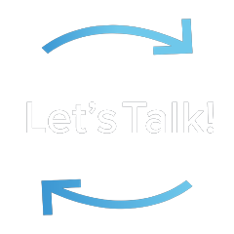
Object-Oriented Talk Buddy
History
Late 1960s and early 1970s: Development of computer networks like ARPANET leads to the creation of the first online chat systems.
1971: Douglas Engelbart develops "On-Line System" (NLS) with message group chat feature.
1990s: Internet Relay Chat (IRC) gains popularity as a real-time communication protocol.
Late 1990s: Instant messaging applications such as ICQ, AIM, and MSN Messenger revolutionize online communication.
Early 2000s: Introduction of voice and video chat capabilities with platforms like Skype and Google Talk.
Dominance of platforms like WhatsApp, Facebook Messenger, and WeChat in the
mobile chat app market.
73

Slide 74
Objective
Enable Real-time Communication
Develop a Chatting Application
Provide User-to-User Messaging
Ensure Message Delivery and Receipt
Support Text-based Communication
Create a User-Friendly Interface
Implement Client-Server Architecture
Utilize Socket Programming for Communication
Ensure Message Formatting and Display
74

Slide 75
Scope
Client-Server Communication
Message Sending and Receiving
User Profile Management
Message History and Logging
Testing and Quality Assurance
Refactoring & Optimization
Online Status and Presence Management
Graphical User Interface (GUI) Development
75

Slide 76
Not in Scope
Audio and Video Calls
Voice Messaging
Artificial Intelligence-based Features
File Transfer
Multiple Language Support
76

Slide 77
Project Plan
01
02
03
Design Phase
Implementation
Phase
Testing
Phase
Identify chat application features and requirements, plan chat application design with OOP concepts, create UI wireframes.
Develop chat application UI, implement chat application logic and rules, implement chat application settings
Conduct thorough testing, test on different systems, ensure requirements are met, optimize performance
77

Slide 78
Project Timeline
Five Weeks
1
2
3
4
5
Brainstorming and Idea Generation
Idea Selection
Design Phase
(1 Week)
Implementation
Phase
(3 weeks)
Testing Phase
(1 week)
78

Slide 79
Project Budget & Team
This project will be developed using open-source tools and software, therefore there will be no cost involved.
The project will be developed by a team of one developer only.
79

Slide 80
Project Functionality & Implementation
80

Slide 81
Input Specifications | Output Specifications
User Profile Settings:
Allowing users to update their profile information, including profile picture, status message, and notification preferences.
Text Input:
Messages entered by the user for sending to the recipient
Chat History: Displaying the conversation history between the user and the recipient.
Received Messages: Displaying the incoming messages from the recipient.
Sent Messages: Displaying the messages sent by the user.
User Status: Indicating the online/offline status of the user.
81

Slide 82
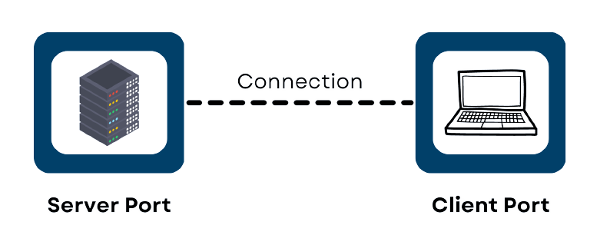
Socket Programming
Socket programming is a crucial component of the chatting application project as it enables communication between the client and server. By using sockets, the application can establish connections, send and receive messages, handle data transmission, and provide real-time updates to users. It allows processes on different machines to connect and exchange data seamlessly, ensuring reliable and instant communication in the chatting application.
Use in Project
Establishing Connection
Sending and Receiving Messages
Handling Data Transmission
Enabling Real-time Updates
82

Slide 83
Hardware Requirements | Software Requirements
Processor: Intel Core i3 or higher
RAM: 4 GB or more
Storage: 500 MB or more
Monitor: 1280x800 or higher resolution display
Input devices: Keyboard and mouse or game controller
Reliable Internet connection
Operating System (e.g., Windows, macOS, Linux)
Java Development Kit (JDK) installed
Integrated Development Environment (IDE) such as Eclipse or IntelliJ IDEA
Swing and AWT libraries for graphical user interface (GUI) development
Understanding of socket programming concepts for establishing network connections and data transmission
Networking libraries for handling network communication and socket programming
83

Slide 84
Execution
84

Slide 85
MainWindow.java
Classes
Server.java
Client.java
85

Slide 86
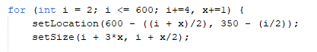
MainWindow.java
This class extends JFrame and implements the Runnable interface. It represents the main window of the application. It creates a window with an image, starts a new thread, and handles the animation for the initial appearance of the window. After a certain time, it makes the window invisible and opens new Server & Client window.
86

Slide 87
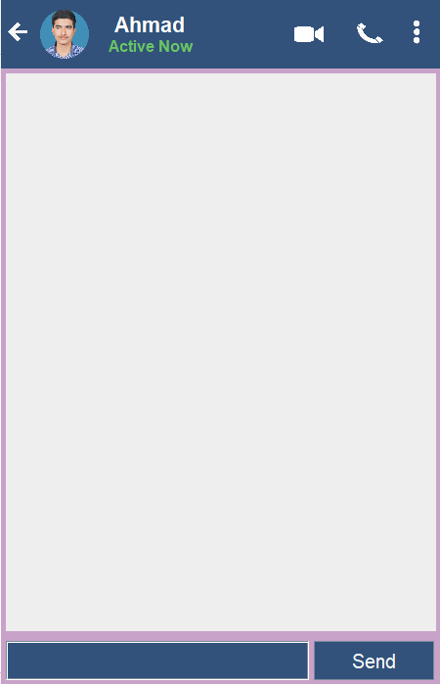
Server.java
The execution process starts by creating an instance of the Server class, which sets up the graphical user interface (GUI) for the chat application. The GUI includes components such as text fields, buttons, and panels for displaying messages. The code then establishes a server socket on port 6008 to listen for incoming connections. Once a client connects, the server creates input and output streams for communication with the client. The server continuously listens for messages from the client using a loop, and each received message is displayed in the GUI by formatting it into a panel. The process continues indefinitely, allowing for real-time chat communication between the server and connected clients.
87

Slide 88
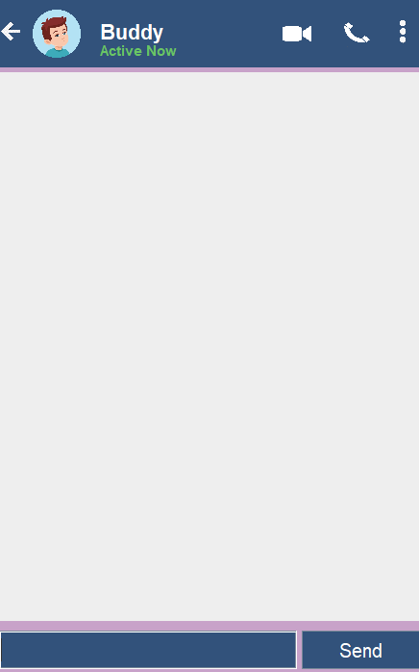
Client.java
The client interface consists of a chat window where users can send and receive messages. The program establishes a socket connection with a server running on the local host and listens for incoming messages. Outgoing messages are sent to the server using a DataOutputStream. The GUI features various components such as profile icons, status indicators, and a text input field for sending messages. Messages are displayed in a panel with timestamps, and the panel is updated dynamically as new messages arrive. Overall, the code implements a basic chat client functionality.
88

Slide 89
Object-Oriented
Programming
Concepts
89

Slide 90
ENCAPSULATION
POLYMORPHISM
INHERITANCE
Inheritance is the process by which one class (called the subclass) acquires the properties and behavior of another class (called the superclass). This allows for the creation of hierarchical classifications of objects, where subclasses inherit the characteristics of their super classes and add additional functionality.
Encapsulation is a mechanism that binds data and code together, protecting them from external interference and misuse. It is achieved through the use of access modifiers such as public, private, and protected, which control the visibility of data and methods in a class
Polymorphism is a feature that allows objects of different classes to be treated as if they belong to a common class. This means that a single interface or method can be used to perform operations on objects of different types. This is achieved through the use of method overloading and overriding, as well as through the implementation of interfaces and abstract classes.
90

Slide 91
OOP Concept
Classes and Objects: The code defines a class called Client which represents the client application for a chat program. Objects of this class are created in the main method to run the chat client.
Encapsulation: The class Client encapsulates the implementation details of the chat client, including the GUI components, event handling, and network communication. The instance variables and methods are appropriately encapsulated to control access and ensure data integrity.
Inheritance: The code does not explicitly demonstrate inheritance, as the Client class does not extend any other class. However, inheritance could be used if the Client class were to inherit from a more generic ChatClient class, which could provide common functionalities to multiple types of chat clients.
Abstraction: The Client class abstracts the complexities of the chat client implementation by providing high-level methods and GUI components. The underlying details, such as network communication, are hidden from the user.
91

Slide 92
OOP Concept
Polymorphism: Polymorphism is not explicitly demonstrated in the provided code. However, it could be utilized if there were multiple types of clients, each implementing a common interface or extending an abstract class, but with different implementations of certain methods.
Method Overriding: The actionPerformed method in the Client class overrides the corresponding method defined in the ActionListener interface. This allows the custom implementation of the method to handle button click events.
Method Overloading: Method overloading is not demonstrated in the provided code. It allows defining multiple methods with the same name but different parameter lists, enabling flexibility in method invocation.
By utilizing these OOP principles & concepts, this project will create a well-structured and maintainable codebase for the chatting application: TalkBuddy
92

Slide 93
Future Enhancements & Works
Multi-User Support
Audio and Video Calls
Artificial Intelligence-based Features
Voice Messaging
File Transfer
Emoticons and Rich Text
User Authentication and Authorization
93

Slide 94
Potential Questions
How can the group chat feature be developed to improve collaboration and communication among participants?
How can artificial intelligence and natural language processing techniques be leveraged to improve the chat client's functionality, such as providing automated suggestions, intelligent message filtering, or sentiment analysis?
How can the chat client's security be further strengthened to protect user privacy and prevent unauthorized access or data breaches?
1
2
3
94

Slide 95
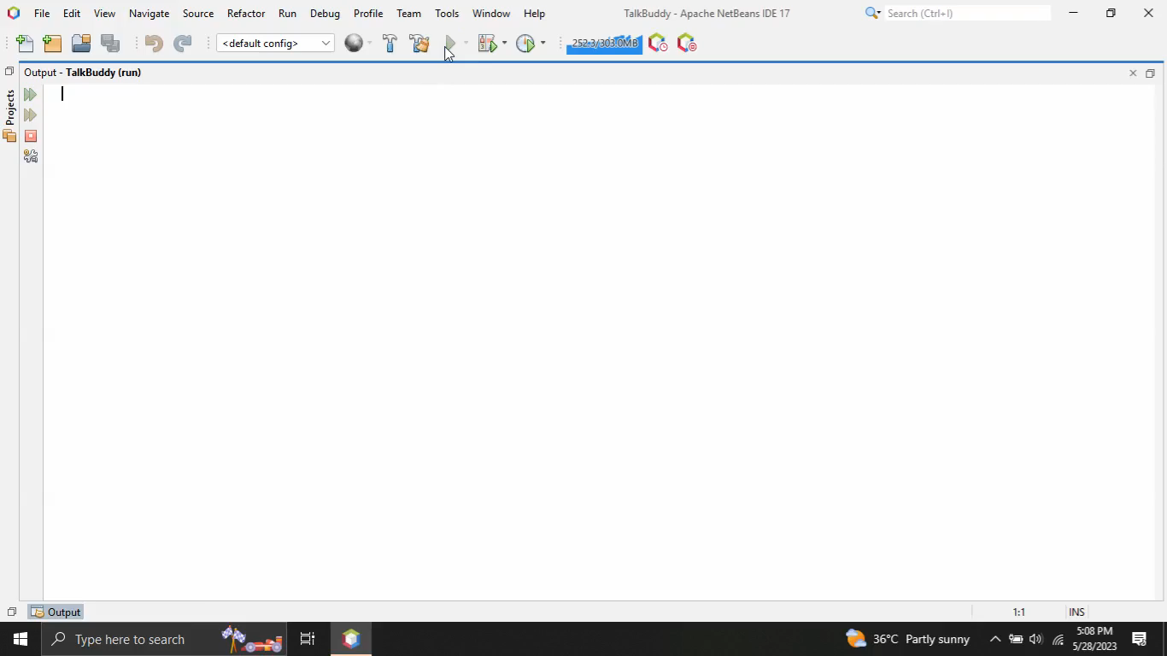
Project Demo
95

Slide 96
Reference Citations
https://www.w3schools.com/
https://stackify.com/java-tutorials//
https://www.codecademy.com/learn/learn-java
https://www.learnjavaonline.org/
96

Slide 97
Any Questions?
Thank you all for your attention! Before we conclude,
I would like to open the floor for questions. Please
feel free to ask anything related to the presentation
or any additional points you'd like to discuss.
97

Slide 98
THANK YOU
Sincerely for your kind attention
98

